Slide 1
Introduction to Computer Graphics with WebGL
Ed Angel
Professor Emeritus of Computer Science
Founding Director, Arts, Research, Technology and Science Laboratory
University of New Mexico
Angel and Shreiner: Interactive Computer Graphics 7E © Addison-Wesley 2015

Slide 2
The Virtual Trackball
Ed Angel
Professor Emeritus of Computer Science
University of New Mexico
Angel and Shreiner: Interactive Computer Graphics 7E © Addison-Wesley 2015

Slide 3
Objectives
This is an optional lecture that
  Introduces the use of graphical (virtual) devices that can be created using WebGL
  Reinforce the benefit of not using direction angles and Euler angles
  Makes use of transformations
  Leads to reusable code that will be helpful later
Angel and Shreiner: Interactive Computer Graphics 7E © Addison-Wesley 2015

Slide 4
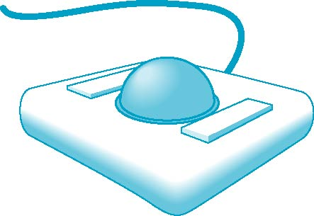
Physical Trackball
The trackball is an “upside down” mouse
If there is little friction between the ball and the rollers, we can give the ball a push and it will keep rolling yielding continuous changes
Two possible modes of operation
  Continuous pushing or tracking hand motion
  Spinning
Angel and Shreiner: Interactive Computer Graphics 7E © Addison-Wesley 2015

Slide 5
A Trackball from a Mouse
Problem: we want to get the two behavior modes from a mouse
We would also like the mouse to emulate a frictionless (ideal) trackball
Solve in two steps
  Map trackball position to mouse position
  Use event listeners to handle the proper modes
Angel and Shreiner: Interactive Computer Graphics 7E © Addison-Wesley 2015

Slide 6
Using Quaternions
Quaternion arithmetic works well for representing rotations around the origin
Can use directly avoiding rotation matrices in the virtual trackball
Code was made available long ago (pre shader) by SGI
Quaternion shaders are simple
Angel and Shreiner: Interactive Computer Graphics 7E © Addison-Wesley 2015

Slide 7
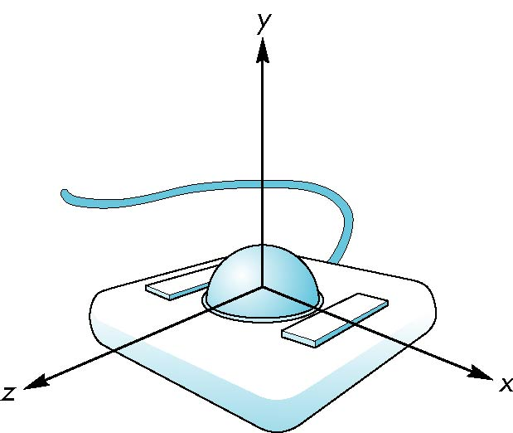
Trackball Frame
origin at center of ball
Angel and Shreiner: Interactive Computer Graphics 7E © Addison-Wesley 2015

Slide 8
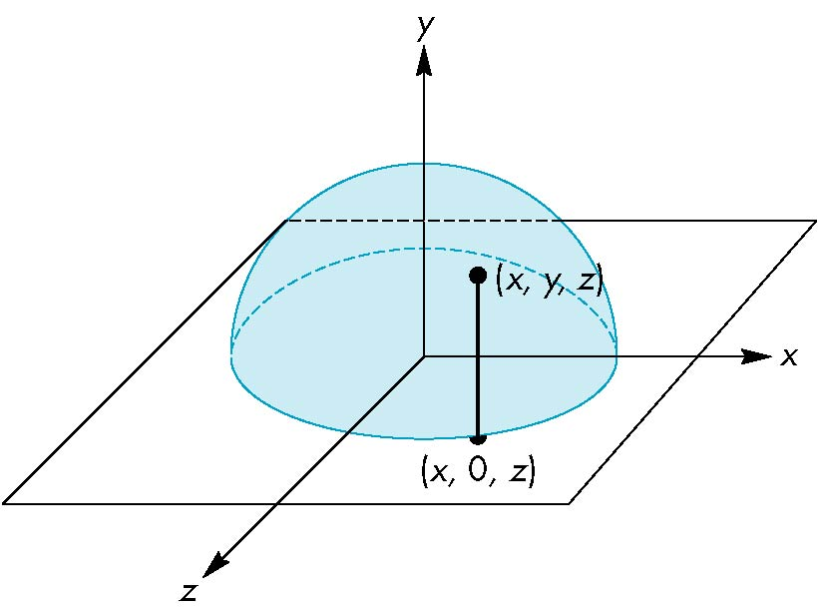
Projection of Trackball Position
We can relate position on trackball to position on a normalized mouse pad by projecting orthogonally onto pad
Angel and Shreiner: Interactive Computer Graphics 7E © Addison-Wesley 2015

Slide 9
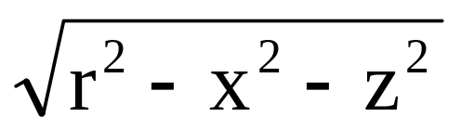
Reversing Projection
Because both the pad and the upper hemisphere of the ball are two-dimensional surfaces, we can reverse the projection
A point (x,z) on the mouse pad corresponds to the point (x,y,z) on the upper hemisphere where
y =
if r ≥ |x|≥ 0, r ≥ |z| ≥ 0
Angel and Shreiner: Interactive Computer Graphics 7E © Addison-Wesley 2015

Slide 10
Computing Rotations
Suppose that we have two points that were obtained from the mouse.
We can project them up to the hemisphere to points p₁ and p₂
These points determine a great circle on the sphere
We can rotate from p₁ to p₂ by finding the proper axis of rotation and the angle between the points
Angel and Shreiner: Interactive Computer Graphics 7E © Addison-Wesley 2015

Slide 11
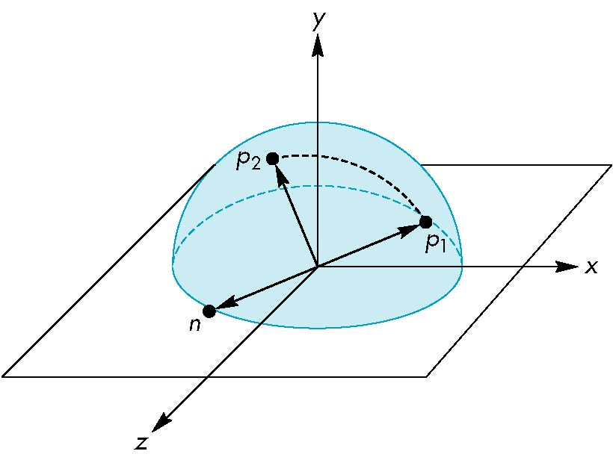
Using the cross product
The axis of rotation is given by the normal to the plane determined by the origin, p₁ , and p₂
n = p₁ × p₂
Angel and Shreiner: Interactive Computer Graphics 7E © Addison-Wesley 2015

Slide 12
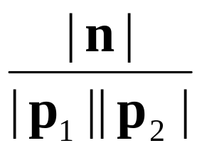
Obtaining the angle
The angle between p₁ and p₂ is given by
If we move the mouse slowly or sample its position frequently, then θ will be small and we can use the approximation
| sin θ| =
sin θ ≈ θ
Angel and Shreiner: Interactive Computer Graphics 7E © Addison-Wesley 2015

Slide 13
Implementing with WebGL
Define actions in terms of three booleans
trackingMouse: if true update trackball position
redrawContinue: if true, idle function posts a redisplay
trackballMove: if true, update rotation matrix
Angel and Shreiner: Interactive Computer Graphics 7E © Addison-Wesley 2015

Slide 14
Vertex Shader I
in vec4 vPosition;
in vec4 vColor;
out vec4 color;
uniform vec4 rquat; // rotation quaternion
// quaternion multiplier
vec4 multq(vec4 a, vec4 b)
{
return(vec4(a.x*b.x - dot(a.yzw, b.yzw),
a.x*b.yzw+b.x*a.yzw+cross(b.yzw, a.yzw)));
}
Angel and Shreiner: Interactive Computer Graphics 7E © Addison-Wesley 2015

Slide 15
Vertex Shader II
// inverse quaternion
vec4 invq(vec4 a)
{ return(vec4(a.x, -a.yzw)/dot(a,a)); }
void main() {
vec3 axis = rquat.yxw;
float theta = rquat.x;
vec4 r, p;
p = vec4(0.0, vPosition.xyz); // input point quaternion
p = multq(rquat, multq(p, invq(rquat))); // rotated point quaternion
gl_Position = vec4( p.yzw, 1.0); // back to homogeneous coordinates
color = vColor;
}
Angel and Shreiner: Interactive Computer Graphics 7E © Addison-Wesley 2015

